Slide 1
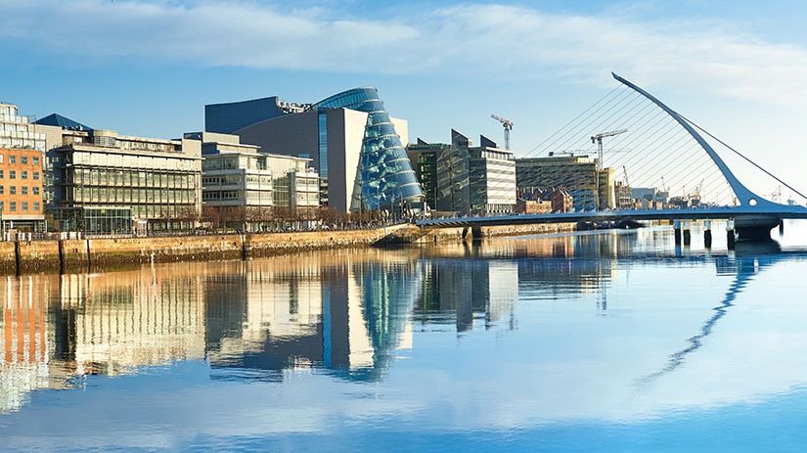
Dublin
Name: Felix Matheis

Slide 2
table of contents
Dublin
Host family
College
Work placement
Intercultural competence
My advice

Slide 3
Dublin
What did you do in Dublin during your free time?
In my free time I had a look around the city. I have visted the city center. I also hiked the cliffs in Howth and Bray. We also met up together and went to the pubs.
What was your favourite activity?
What I liked most was when we went to the stadium and watched a Europe League match.

Slide 4
Host Family
What did you like about your host family?
What I liked most about my host family was that we got our own key. That meant I could leave the house at any time and could come back whenever I wanted.
Did you spend a lot of time with them?
No, I hardly have spent any time with my host family.
Would you like to visit your hosts again?
No, I wouldn‘t visit the host family again but I would visit Dublin again.

Slide 5

College
What did you like about the college?
The staff was very friendly and helpful.
What did you learn during the language course?
I learned a lot about Dublin and the history. I also learned more about business English.

Slide 6

Workplacment
What did you do during your work placement?
I have entered the monthly income and expenses of companies in excel.
What did you like?
I like that the staff was very frindly and behaved very nice.
What did you learn?
I got to know and see a working day in Irland.
In what ways was working in Ireland different from working in Germany?
The working hours and the breaks are different. In Dublin it wasn‘t bad if you were late.

Slide 7
My advice
What can students do to make sure that the project is a success?
The project was a very nice experience for me because the people there are so nice and you can get in touch with them so easily.
You can visit so many beautiful places in your free time. In your free time it is like you are on vacation.
You improve your English because you have to speak English with your host family and at the work, too.
I am glad that I took part in the project and can only recommed it. The memory will last forever.

