Slide 1
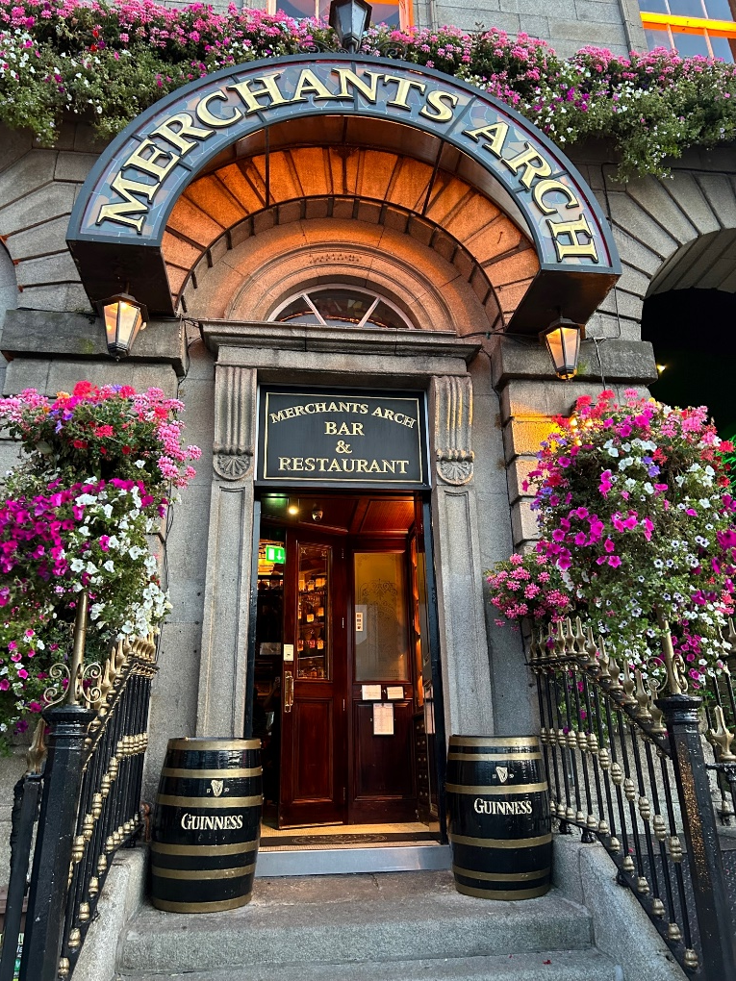
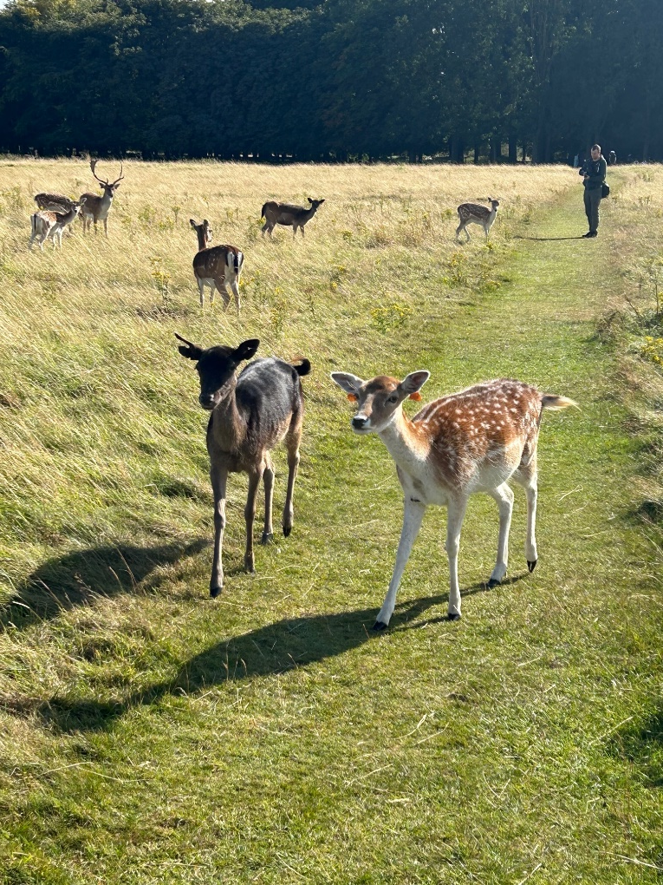

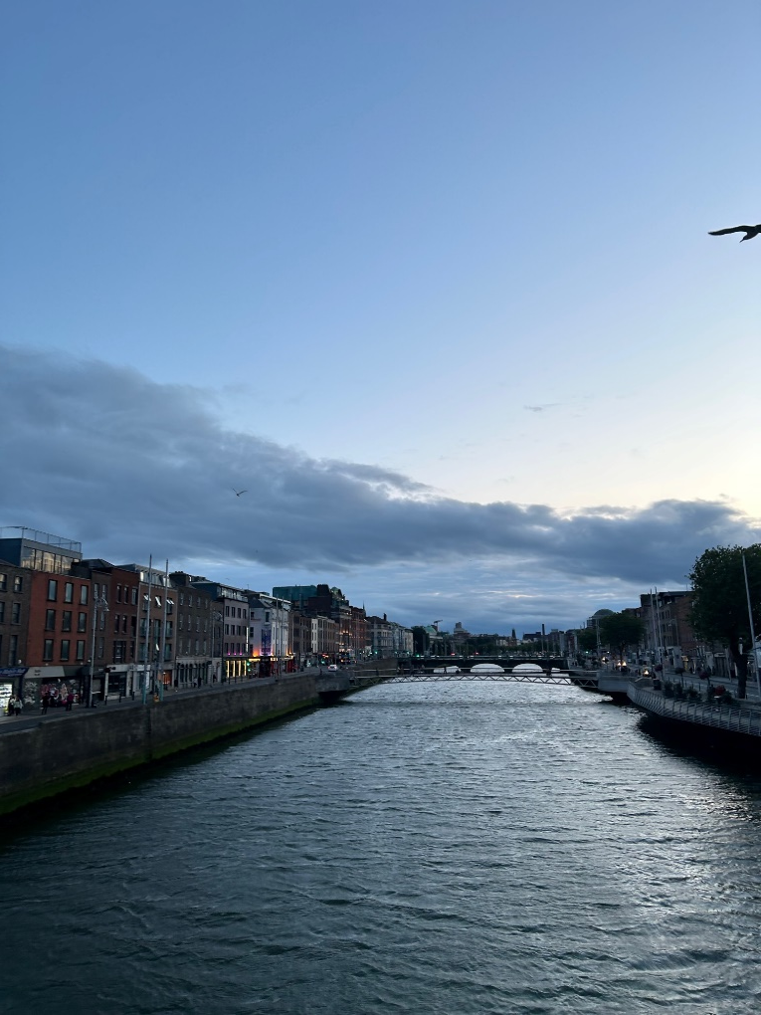
Erasmus+ (Dublin 2024)

Slide 2
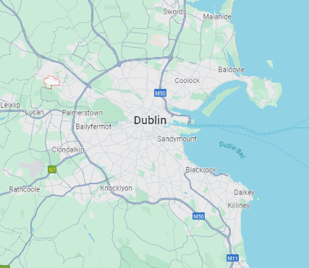




My Host Family
During our stay in Dublin, we lived in Clonsilla, a small neighbourhood in the West of the city.
We were a group of three people and we had our own bedroom including three beds and an ensuite bathroom for our own.
The family offered us breakfast and dinner which was served at 6pm but we were also free to eat it later.
The family was really polite and caring, we didn't engage much with them, but if we did they helped us with everything we asked for.
I really liked that the family offered fresh and healthy food everyday.
My host family lived away from the city centre trouble which led to long train drives, especially to my workplace.
Our Guest Family
My Workplace

Slide 3
ADC College
During the first week we had a language course at ADC College.
The teacher taught us about the Irish culture and the Irish work culture.
I liked that we also learned business vocabulary through a role play which was called “Shark Tank.“
I did not like that most of the time in the language course was filled with playing small games which included very basic vocabulary.
Nevertheless, the language course was a good start to get used to Dublin and to prepare for the upcoming internship.

Slide 4
Work Placement (ALIGN)
For my two week internship I was placed at a Company called ALIGN.
They help other businesses to grow their sales and generate leads for them.
They do that by calling other businesses that could potentially be a fit for the customer.
During my internship my tasks were:
  searching & creating lists of potential customers
  sending , “follow-up emails“
  listening to interesting “business calls.“
I really enjoyed the internship at ALIGN, the team was very friendly, and I liked chatting with them. Through that I really improved my English skills.

Slide 5
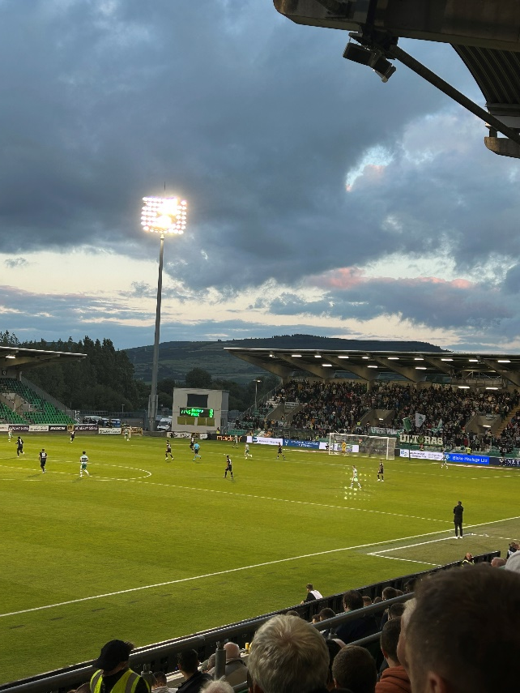
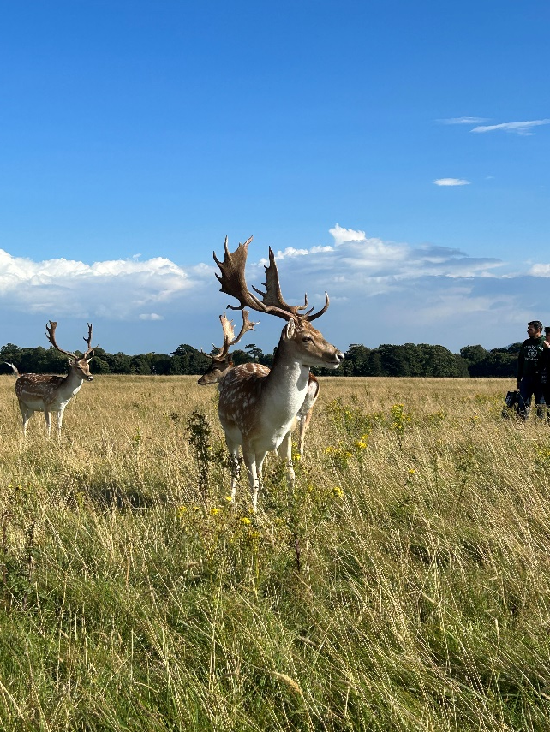
How I spent my free time
We spent time discovering the nature of Dublin.
We really liked Phoenix Park, it is located in the middle of Dublin and it features amazing wild life like deers.
On Thursday, 29th. August we watched the Europa League football game between Shamrock Rovers and PAOK.
Shamrock Rovers is one of the biggest clubs in Ireland, compared to German clubs the Irish ones seem really small.

Slide 6
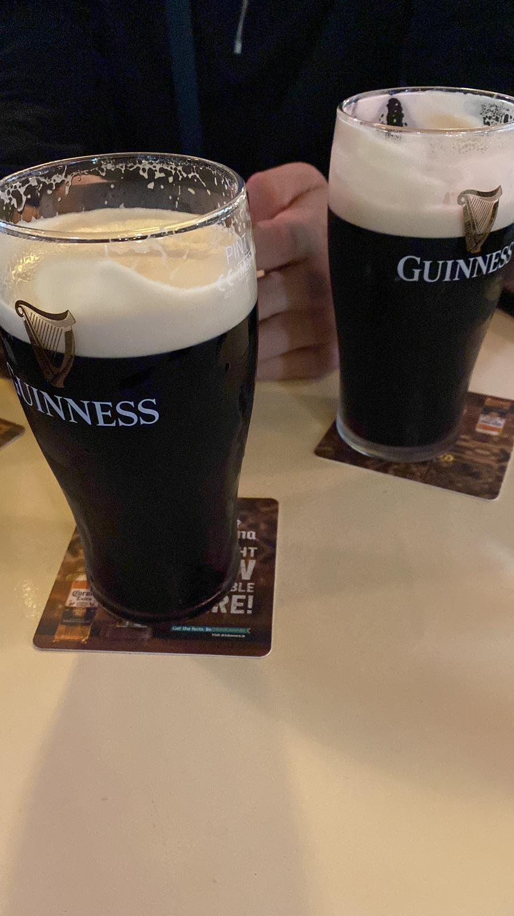
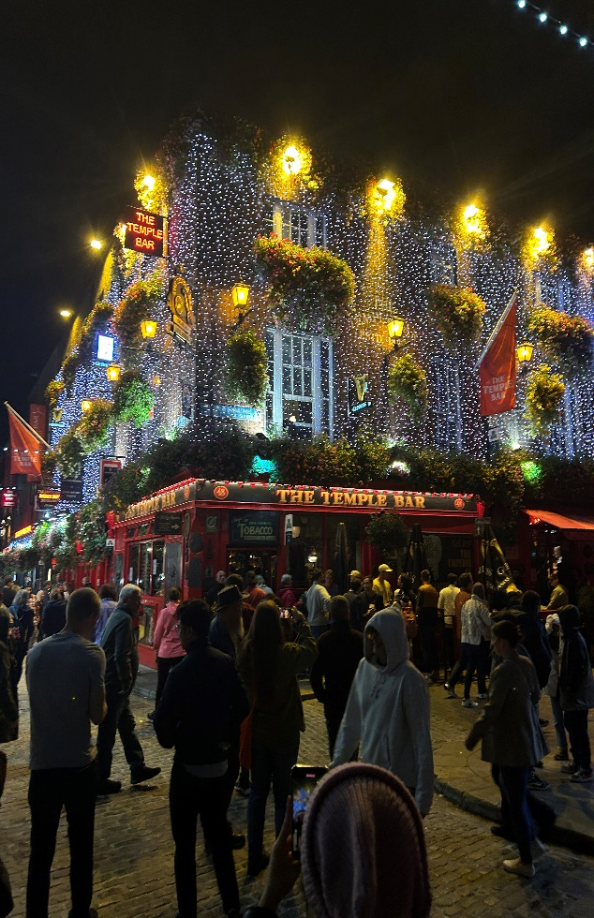
How I spent my free time
On weekends, we got to know the Irish pub culture.
We tried the famous Irish Guinness Stout which tastes great.
The city centre of Dublin features pubs at every corner.

Slide 7
Intercultural Competence
During my internship I started to notice the difference in culture between Ireland and Germany.
In Ireland people at work a really informal, they call everyone directly by their first name while in Germany you always call people by their last name until they offer you to call them by their first name.
In Ireland most of the people are less stressed, they do not really care if they arrive late at the office by 10 minutes.
People in Ireland really like small talk, whether it is in the bus, at work or elsewhere it is common that people will start talking to you. In Germany, most people do not like that, they want to be left alone.

Slide 8
My Advice
If you want to make sure this project is a success you have to watch out for the following things:
  Do not be too shy, if you want to learn new skills you have to engage with the Irish people.
  You have to be independent of others, and sort things out on your own.
  You have to accept that the host family will have rules or habits that you might not like.
  You have to be willing to learn, otherwise you will not learn anything new.
  You have to accept cultural differences, Irish people do not live like Germans do.

