Slide 1
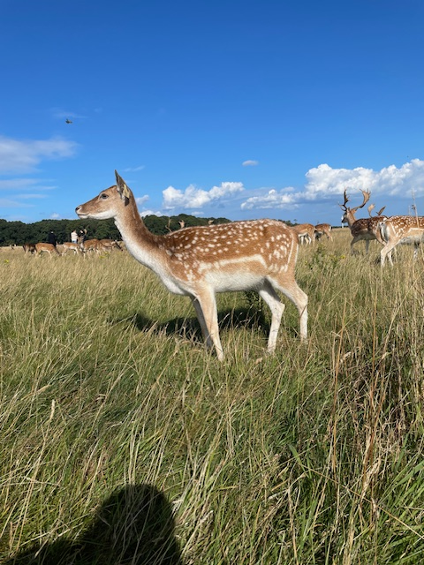
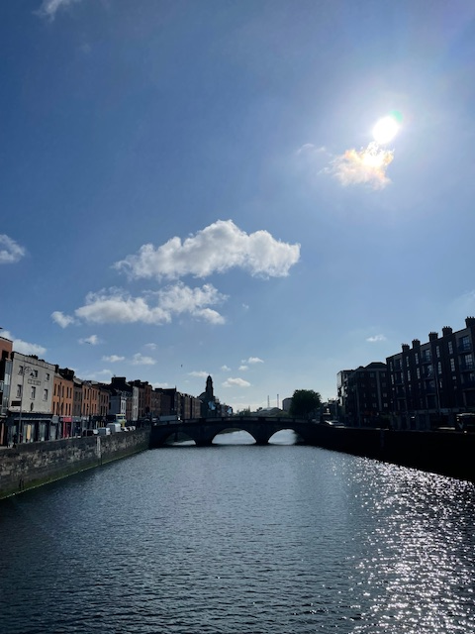
Illustrated Report on our Project in Dublin, Ireland
Ben Frömmer

Slide 2
Dublin-activities
Exploring Dublin and the nature.
Shopping in Dublin and different shopping malls.
Visiting the Phoenix Park.
Exploring the Tempel Bar district.
Get to know our neighbourhood.
I went to a soccer game of the Shemrock Rovers.

Slide 3
Host family
During this internship I lived with two other participants in Clonsilla, a small neighbourhood.
The host family was very kind and helped us with everything.
We had our own bedroom and bathroom and, like the rest of the house, it was very clean.
We were served with warm food everyday and our clothes got laundred.
I would definitely visit the family again.

Slide 4
College
The first week of the internship we had school at the ADC College
  The teacher taught us the Irish history and culture.
  We learned to speak English more fluently.
  Learning and using business vocabulary.
  We played many small games which always included speaking English like „Dragons Dent.“
  The English course was helpful to get to know Dublin and learning English during the first week.

Slide 5

Work placement
For the internship I worked at Eastern Electrical, an electrical whoelsaler.
During my time in the company I sorted invoices and proof of deliveries.
This was not really helpful or useful.
The staff was very kind and helped me when I needed support.
I had in total 4 hours of traveltime every day.

Slide 6
Intercultural competence
During the 3 week internship I noticed some differences between the Irish and the Germans:
  The Irish people are more relaxed and less stressed than the Germans.
  Everybody works from 9am to 5pm.
  Anywhere I was I had some small talk with people I did not know.
  In Germany, the workplace is very formal, but in Ireland it is more informal.
    For example: You always call someone by their first name.

Slide 7
My advice
Don`t be scared, try to learn as much as possible.
Don´t be shy, the Irish people are extremely kind.
Try to adapt to the Irish culture.
Go to the city and visit sightseeing spots.

