Slide 1




Erasmus + Programme Dublin

Slide 2
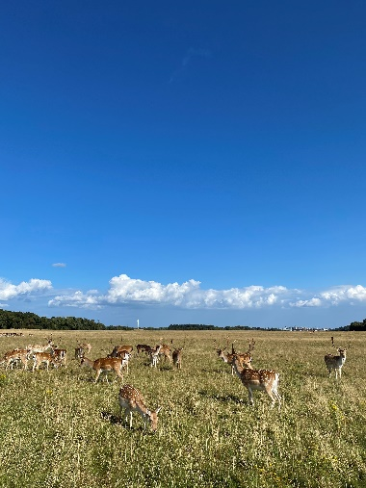
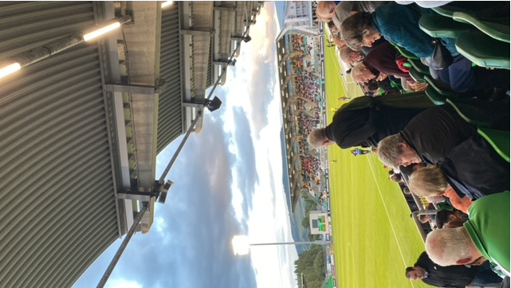
Free Time Activities
Explored Dublin’s nature
Phoenix Park: central location, amazing wildlife (deers)
Europa League match: Shamrock Rovers vs. PAOK (29th. August)
  Comparison: Irish football clubs seem small compared to German clubs
Weekends: discovered Irish pub culture
  Tried the famous Guinness Stout
  Pubs on nearly every corner in Dublin’s city center

Slide 3
Host Family
Stayed in Clonsilla (a suburb in the west of Dublin)
Group of three: private room with three beds and a room with an ensuite bathroom
Breakfast and dinner served at 6 pm, but flexible to eat later
Family: polite, helpful, but limited interaction
Daily fresh and healthy meals provided

Slide 4

ADC College
Attended a language course during the first week
Learned about Irish culture and work environment
Learned business vocabulary through the “Shark Tank” role play
Critique: simple games focused on basic vocabulary
Conclusion: Good introduction to Dublin and preparation for the internship

Slide 5

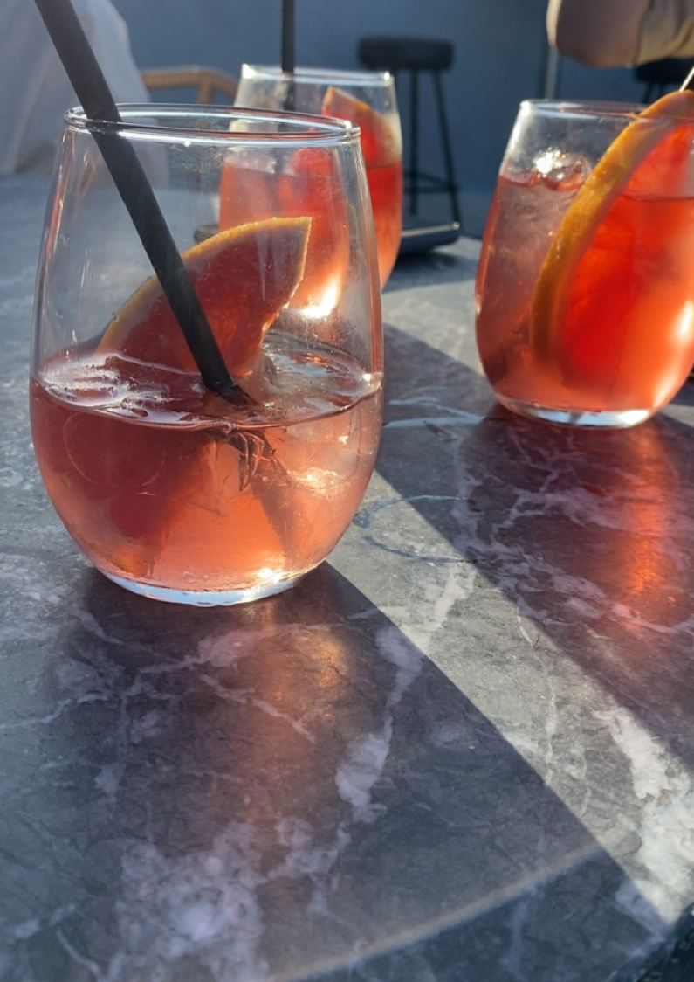
Stillgarden Distillery
During the two-week internship I worked for Stillgarden Distillery
This is a gin distillery located in Dublin 8, Inchicore
They offer various craft spirits from different gins, from vodka to their liquors and aperitifs
I really enjoyed my time at this workplace because of the people and the variety of tasks that were given

Slide 6
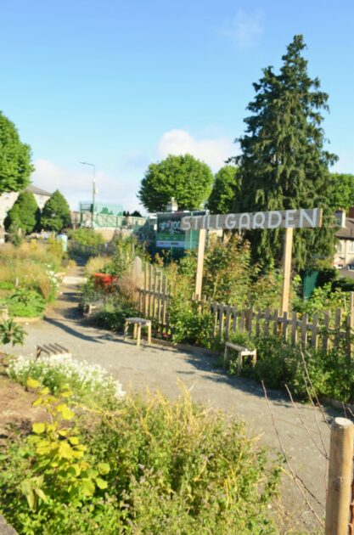

My tasks at Stillgarden
Watering and cleaning the garden
Assisted at cocktail masterclasses and gin tastings
Supported different kinds of events like the Espresso Martini Event at Hyde Bar
Searched for email addresses of golf and tennis clubs
Designed a template for an instagram post
Bottle labeling

Slide 7
Cultural Differences
Informal work culture: first-name basis in Ireland (compared to Germany)
Less stress: being 10 minutes late is not a big issue
Small talk is common in Ireland (on the bus, at work, etc.)
  In Germany, people generally prefer to be left alone

Slide 8
Tips for Success
Be open and engage with people
Independence and problem-solving are important
Accept the rules and habits of your host family
Be willing to learn new things
Accept cultural differences – the Irish live differently than Germans

