Slide 1

Erasmus+ 2024 Dublin
By
Maik Dyck

Slide 2
What did you do in your free time and what was your favourite activity?
Exploring (Bayside, Howth, Temple Bar District, Parks, Trinity College, Kilkenny, Wicklow Mountains, Glendalough, National Gallery of Ireland, Bray)
Shopping (clothing, gifts, souveniers)
My favourite activity was by far the day trips to Killkenny, Wicklow Mountains and Glendalough. Everyone should really try to make a full day tour trip on Saturdays!

Slide 3
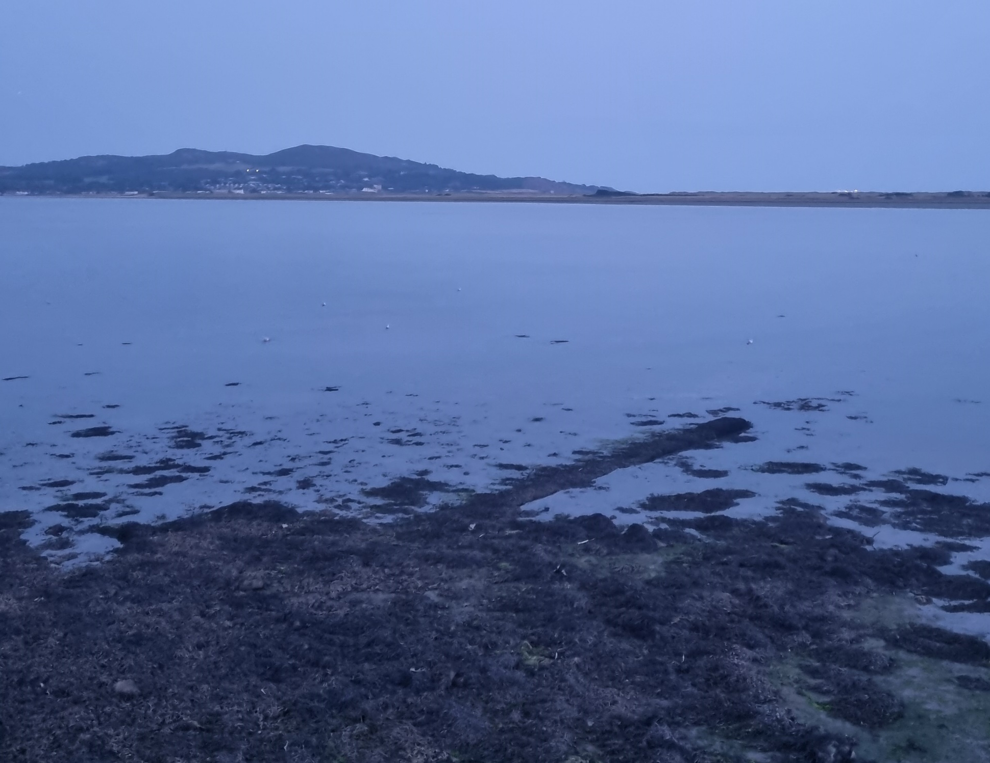
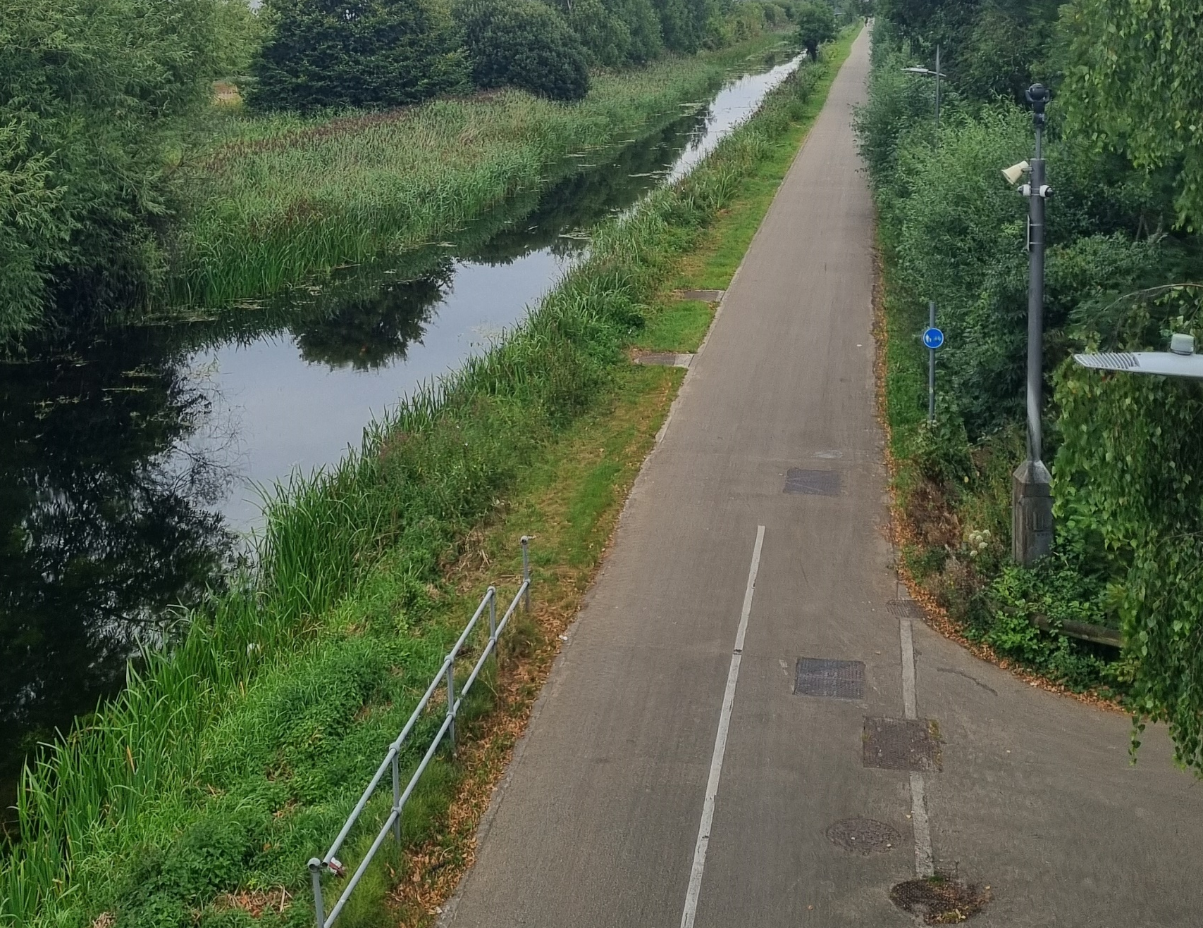
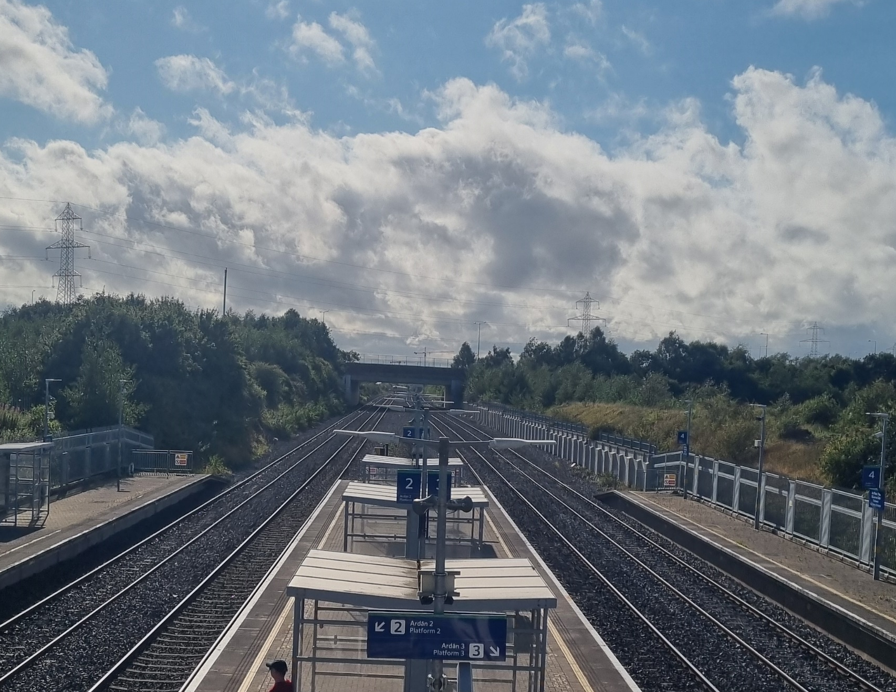
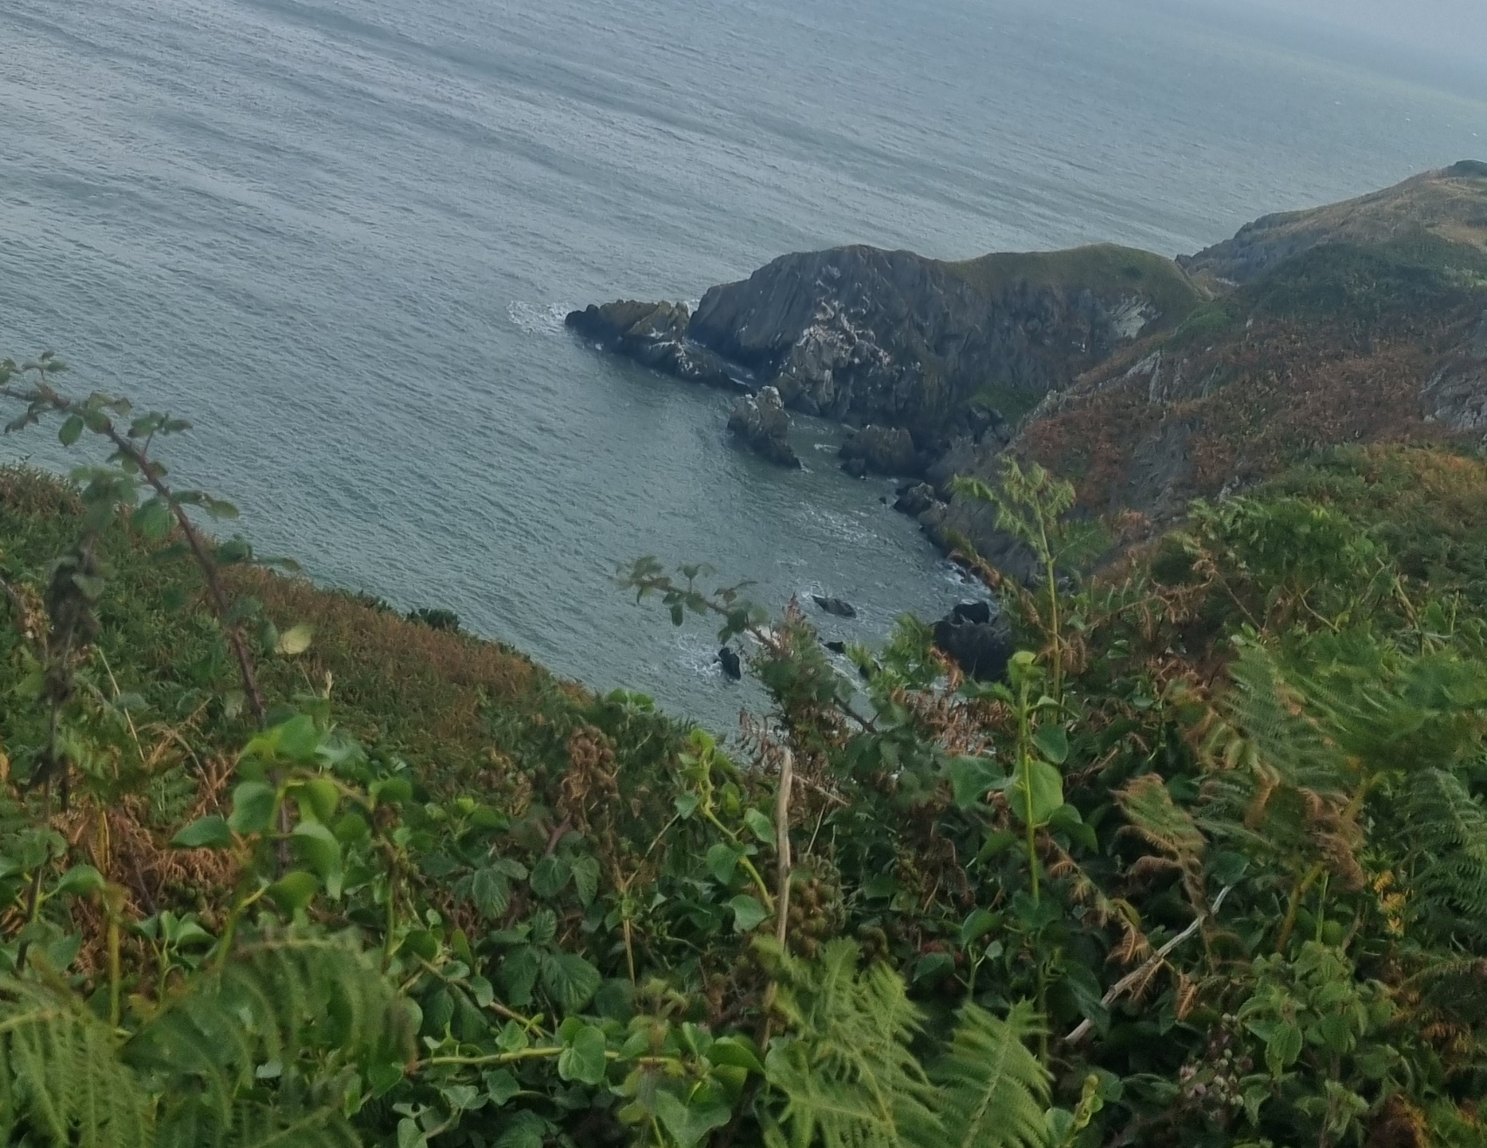
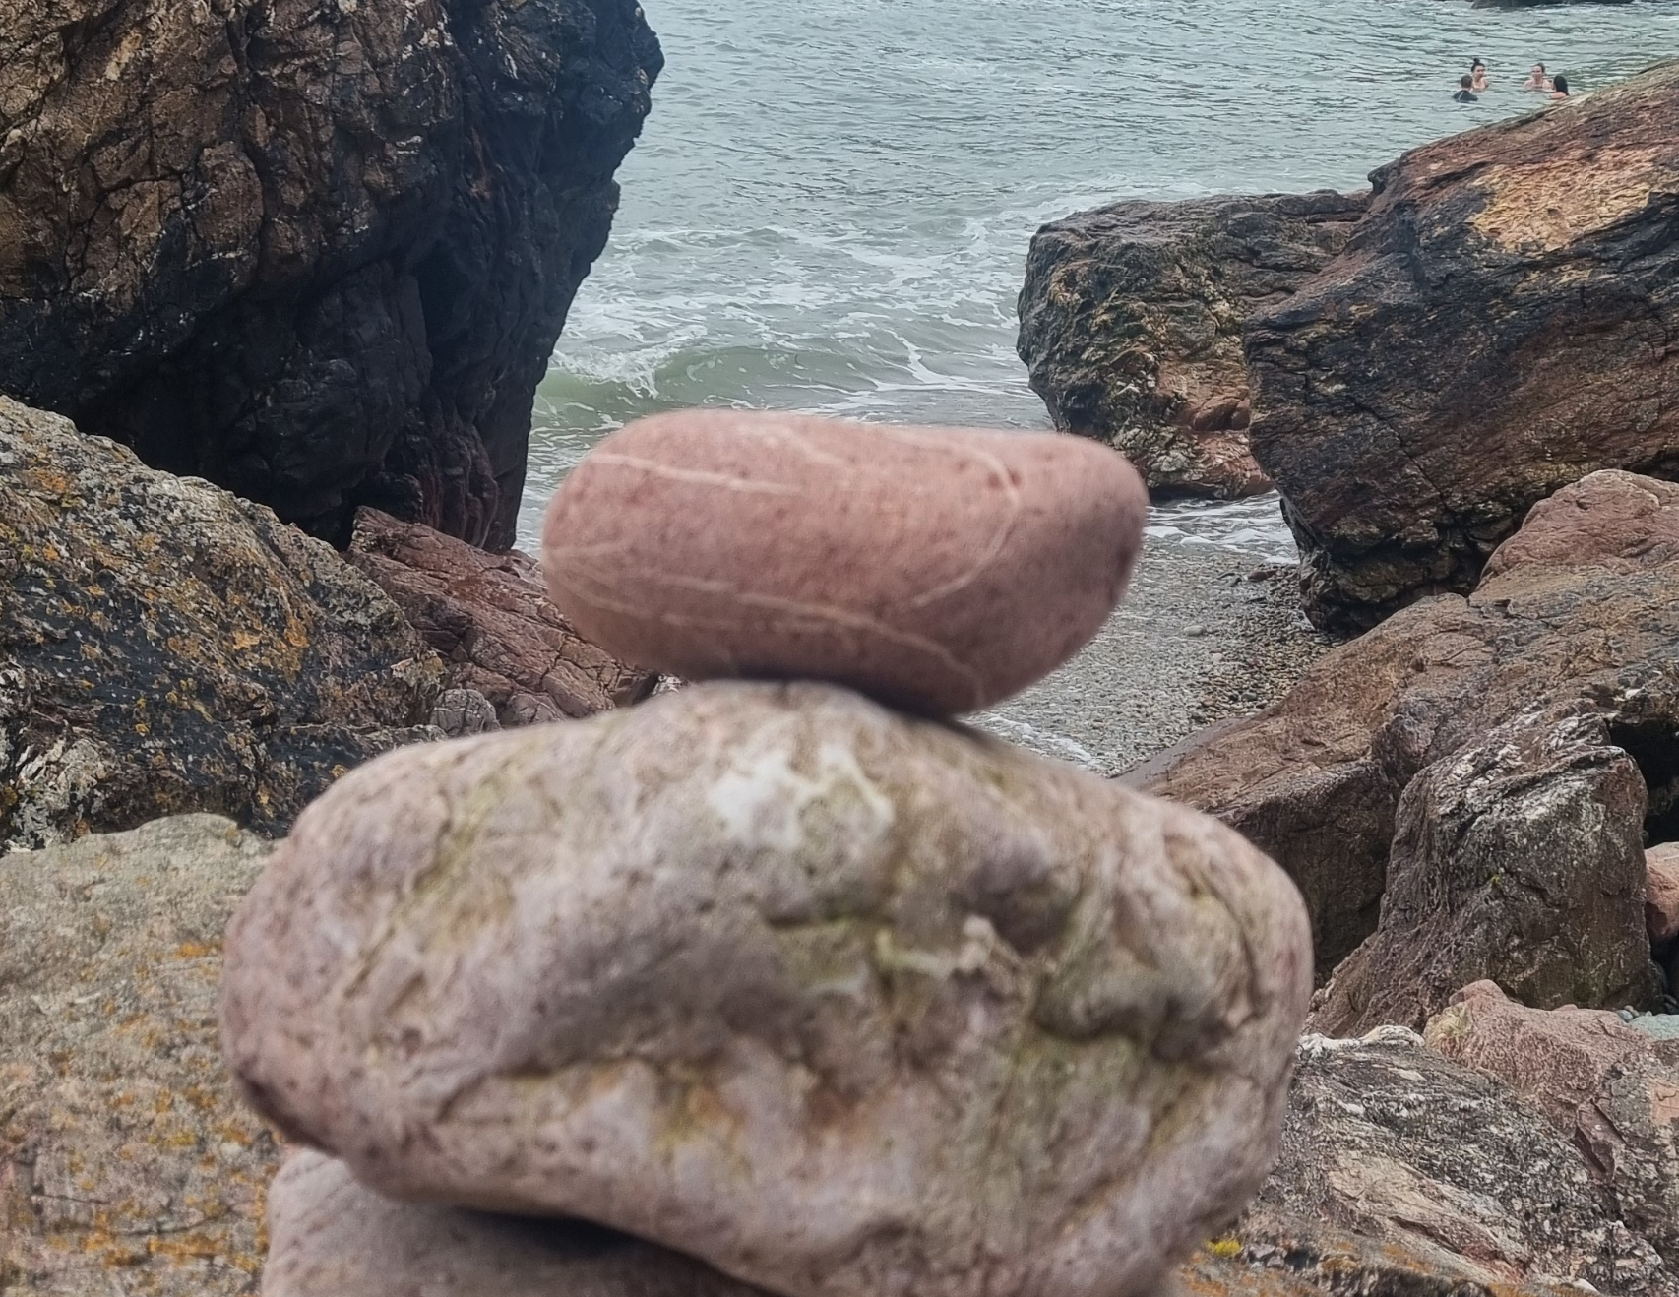
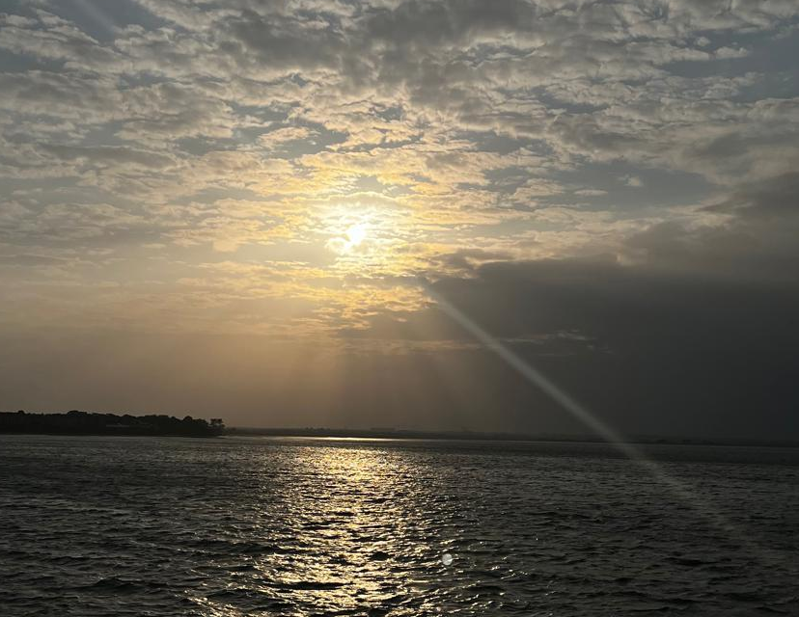

Slide 4
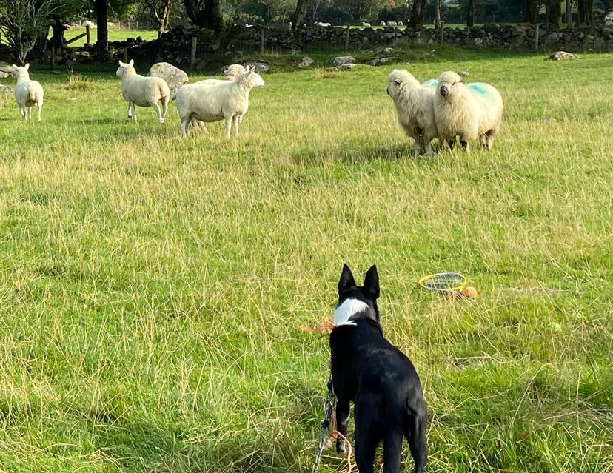
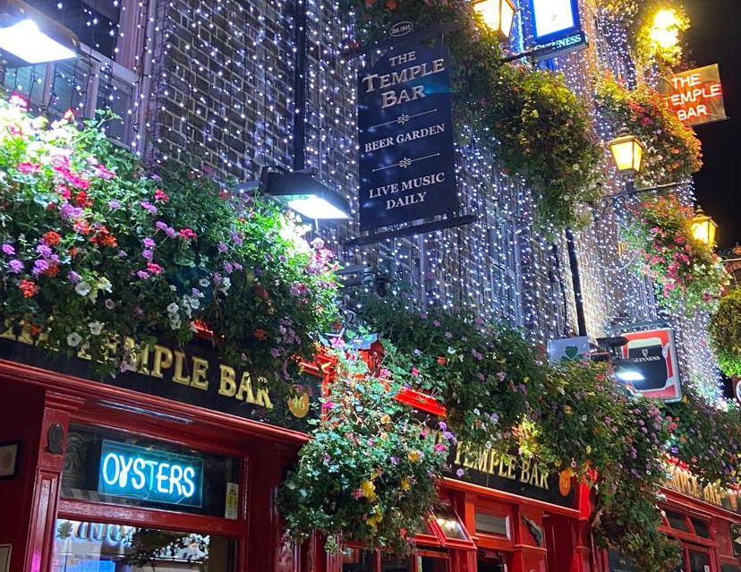
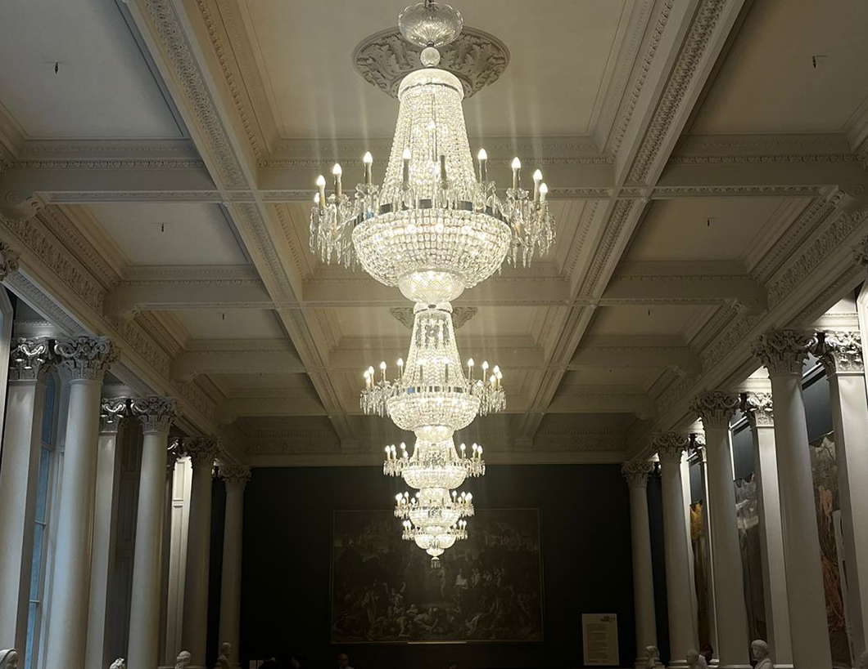
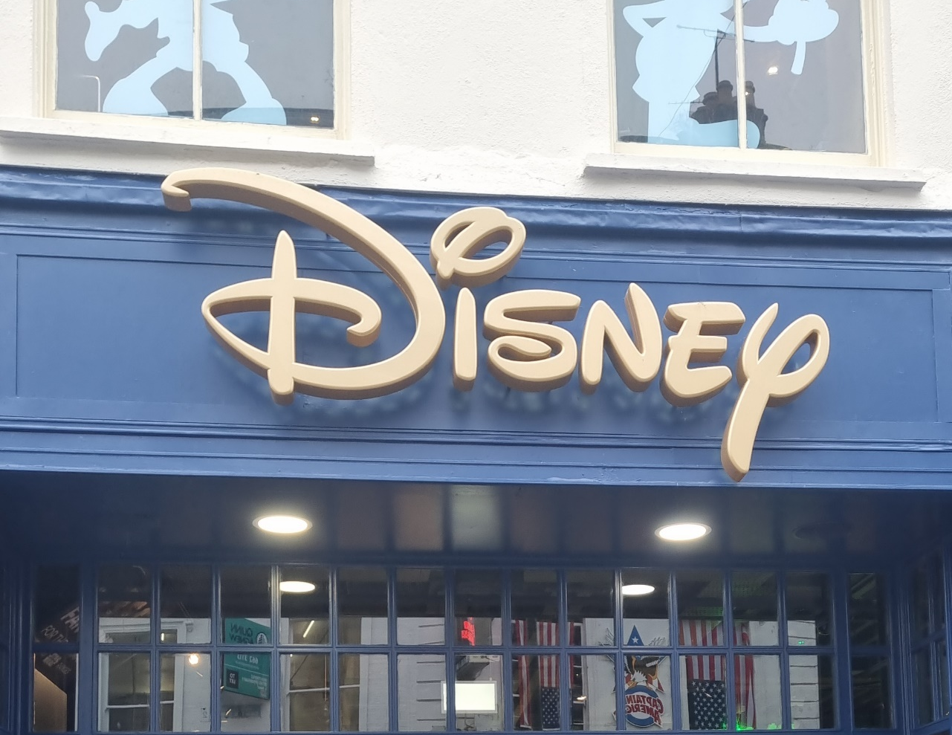
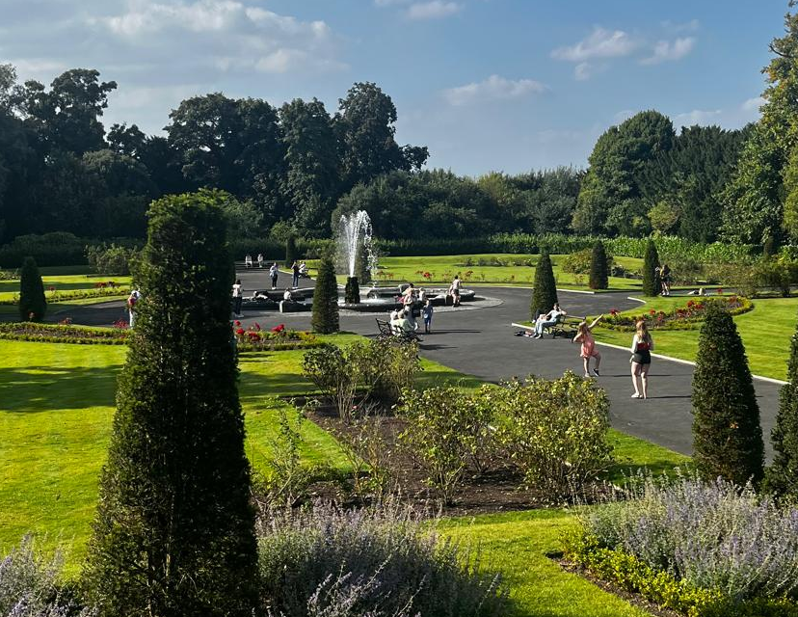
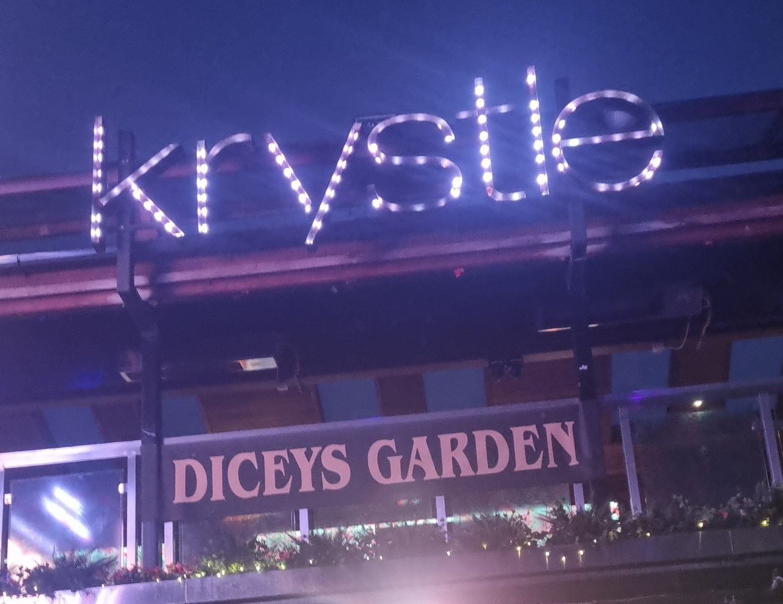

Slide 5
What did you like about your host family? Did you spend a lot of time with them? Would you like to visit your hosts again?
I really enjoyed their personality, great humor and we basically had no strict rules.
No, because we explored Dublin everyday and night, on some days I did not see them once.
In the house we lived in, absolutly not! Regarding the city, there is a chance to visit it again.

Slide 6
What did you like about the college? What did you learn during the language course?
I liked the teacher, James. He was a really nice guy and that the ADC-Team was always quick with responding to our emails.
It was nice to learn how to negotiate like a businessman during the Dragon‘s Dent game.

Slide 7
What did you do during your work placement? What did you like? What did you learn? In what ways was working in Ireland different from working in Germany?
Update the databank, created a PowerPoint for the Forensic Science Ireland and several Word templates.
I really enjoyed the working atmosphere.
I learned that Pembroke Privacy is the kind of company I want to work for in the future.
Pembroke Privacy is much more advanced compared to my company in Germany with benefits, working from home and atmosphere.

Slide 8
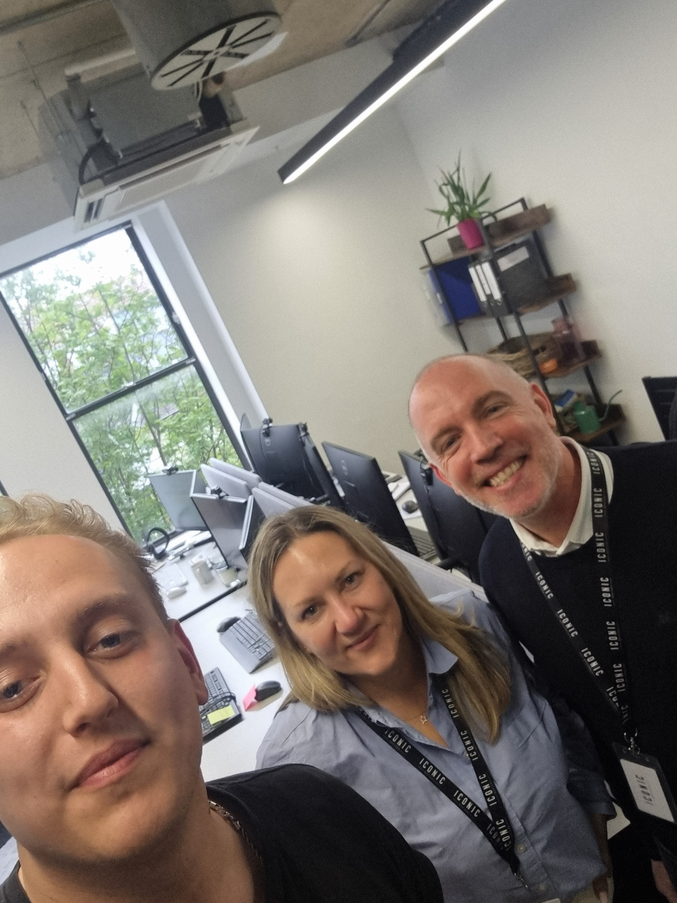

Slide 9
What did you learn about Irish culture in general, Irish English and good behaviour in Ireland? Did you see any notable differences between Ireland and Germany? If so, how did you deal with these differences? Please also tell us about similarities.
I learned about the Irish culture that they are much more friendly and open to chat to everyone. I think germans could learn from that. I really enjoyed that people thank the bus driver.
A big difference were the train stations because in Ireland they were much cleaner and much more safe. Another mayor difference, at least in my host family, was how much cleaner and healthier I live and the portion size of the meals. We just had to except our fate and buy more food.

Slide 10
What can students do to make sure that the project is a success?
Make the most out of your time. Explore every day, even if you are tired after work.
Try to small talk as much as possible.
Exploring alone can be fun, but in my opinion it is much better to do it with a group – do not be afraid to ask people to join you.
Temple Bar District is a money scam, go there for the atmosphere not the drinks.

